Slide 1
CSS
By Vivek Gohil

Slide 2

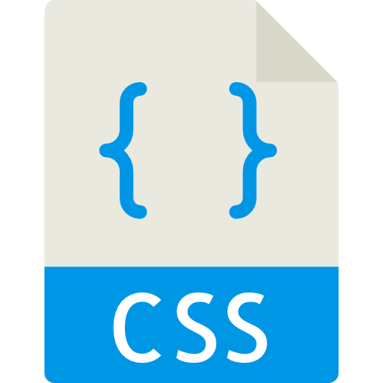
What is CSS ?
The Structure of the page
Required
The Style of the page
Optional

Slide 3
What CSS Can do for us ?
Open the index.html file from folder 1-css-in-action in browser
Copy and paste code from main.css file and add it in the header by creating new style tag.

Slide 4
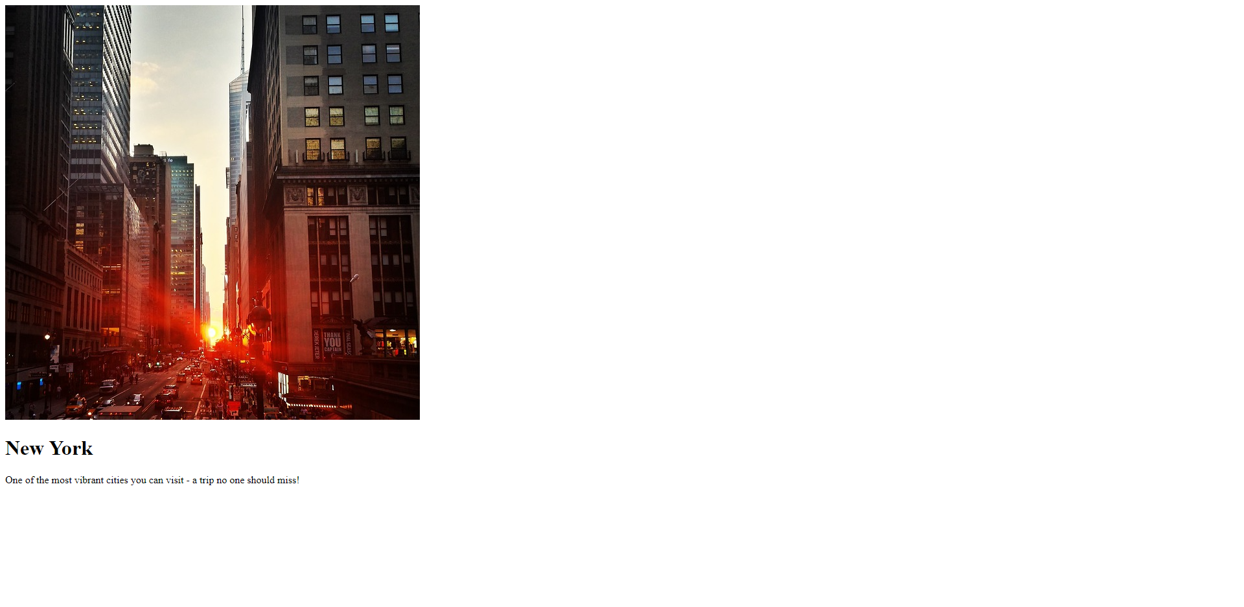
What CSS Can do for us?
index.html (Without CSS)

Slide 5

What is CSS ?
index.html (with CSS)

Slide 6
CSS History , Present & Future
CCS 1
Released in 1996
CSS 2
Released in 1998
CSS 3
In Development

Slide 7
Course Outline
Basic Track
Getting Started
Advance Track
Backgrounds & Images
Expert Track
Flexbox
The Basics
Diving Deeper
Selectors & CSS Features
Practicing Basics
Positioning
Dimensions, Uinits & Size
JavaScript & CSS
Responsiveness
Styling Forms
Working With Fonts
CSS
Transformations
Transitions & Animations
Writing Future-Proof CSS
SASS Introduction

Slide 8
How to get the most out of this training ?
Training
Code Along & Do Exercises
Debug Errors

Slide 9
Recommended Tools
Code Editor : Visual Studio Code
Download Visual Studio Code: https://code.visualstudio.com/
Browser : Chrome – Powerful developer tools
Download Google Chrome: https://www.google.com/intl/en/chrome/

Slide 10
Understanding the basics
Lets get started and dive into the world of CSS

Slide 11
What’s inside this module?
How to add CSS to HTML
Setting up CSS Rules
Selectors , Properties and Values
Conflicting Styles

Slide 12
Setting up course project
We will create new web hosting site.
Create new folder as HostingWebsite
Create new file as index.html

Slide 13
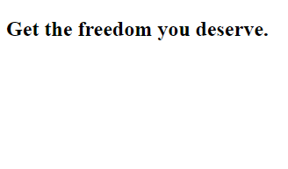
Understanding the course project setup
index.html
<!DOCTYPE html>
<html lang="en">
<head>
<meta charset="UTF-8">
<meta http-equiv="X-UA-Compatible" content="ie=edge">
<title>uHost</title>
<link rel="shortcut icon" href="favicon.png">
</head>
<body>
<main>
<section>
<h1>Get the freedom you deserve.</h1>
</section>
</main>
</body>
</html>
ouput

Slide 14
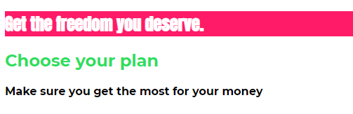
Project Goal Of This Module

Slide 15
How to add CSS to HTML
Inline Styles – Code Example
<style> tag – Code Example
External file (.css) – Code Example – Recommended

Slide 16
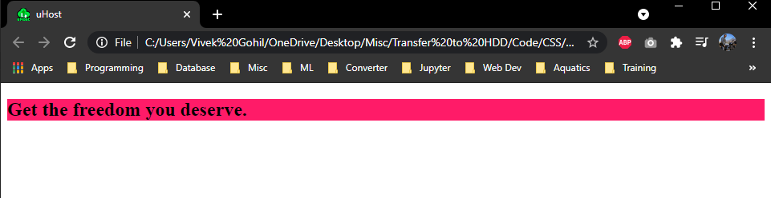
Inline Styles
Using inline styles change the background of section tag
index.html
<body>
<main>
<section style="background: #ff1b68 ">
<h1>Get the freedom you deserve.</h1>
</section>
</main>
</body>

Slide 17
Using <style> tag
Remove the inline style applied in previous slide.
Add style tag in head section
Set the background property using selector

Slide 18
Using <style> tag
index.html
<head>
<meta charset="UTF-8">
<meta http-equiv="X-UA-Compatible" content="ie=edge">
<title>uHost</title>
<link rel="shortcut icon" href="favicon.png">
<style>
/* rule */
/* selector */
selection{
background: #ff1b68;
}
</style>
</head>

Slide 19
Using <style> tag
Add one more section tag in main and check the output
index.html
<main>
<section>
<h1>Get the freedom you deserve.</h1>
</section>
<section>
<h1>Choose your plan</h1>
</section>
</main>

Slide 20
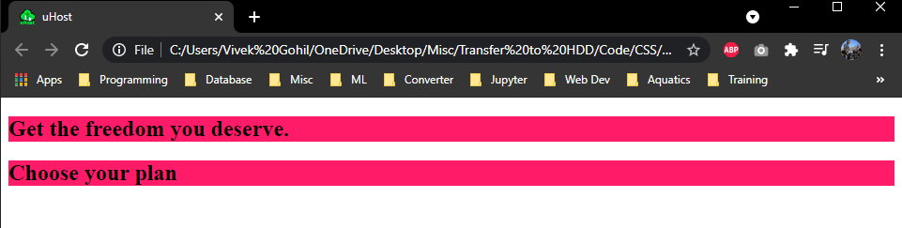
Using <style> tag

Slide 21
Using External file (.css)
Create new file as main.css in HostingWebsite folder.
Cut the css rule defined in style tag and paste in main.css file.
Remove the style tag from index.html file.
Include the link of main.css in index.html file.

Slide 22
Using External file (.css)
index.html
<head>
<meta charset="UTF-8">
<meta http-equiv="X-UA-Compatible" content="ie=edge">
<title>uHost</title>
<link rel="shortcut icon" href="favicon.png">
<link rel="stylesheet" href="main.css">
</head>
main.css
section{
background: #ff1b68;
}

Slide 23
Applying Additional Styles and Google Fonts
Change font style
Change colour of text
Apply the different style to both section
Change positioning of text

Slide 24
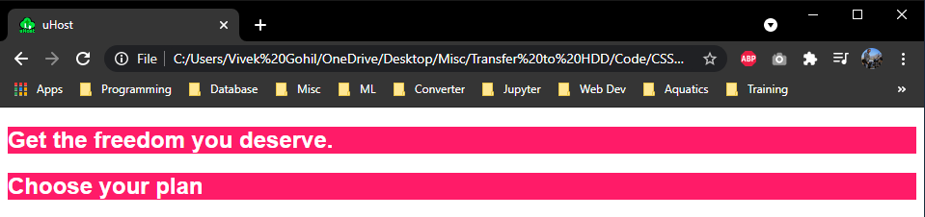
Change font style and font color
Add new selector to the h1 in main.css
Add color property
Add font-family
h1
{
color: white;
font-family: sans-serif;
}

Slide 25
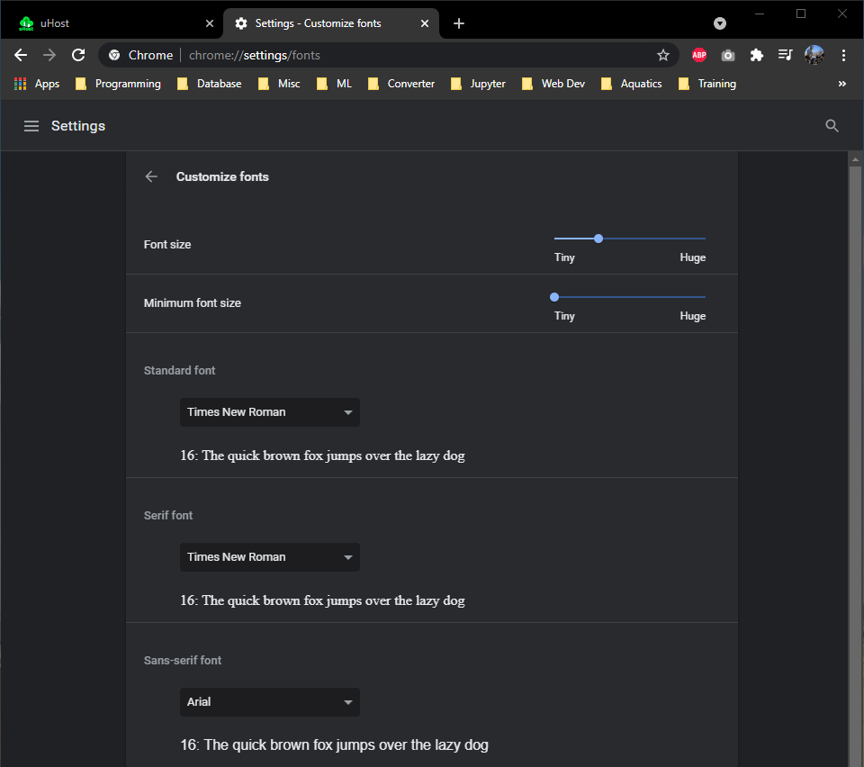
Change font style and font color
From where we are getting the font : sans-serif
Open the browser font settings link :: chrome://settings/fonts

Slide 26
Change font style and font color
Add customized font from Google Font
Open google font link :: https://fonts.google.com/
Search font :: Anton
Import the font link in your html file
Copy the font-family rule in main.css file

Slide 27
Change font style and font colour
index.html
<head>
<meta charset="UTF-8">
<meta http-equiv="X-UA-Compatible" content="ie=edge">
<title>uHost</title>
<link rel="shortcut icon" href="favicon.png">
<link rel="preconnect" href="https://fonts.gstatic.com">
<link href="https://fonts.googleapis.com/css2?family=Anton&display=swap" rel="stylesheet">
<link rel="stylesheet" href="main.css">
</head>
main.css
h1
{
color: white;
font-family: 'Anton', sans-serif;
}

Slide 28
Selectors in CSS
Element Selector
Class Selector
Universal Selector
ID Selector
Attributes Selector

Slide 29
Selectors in detail
Elements
<h1> Our Header</h1>
<p> The Blog Post </p>
<div> More Info </div>
h1 {
color : red;
}
Set equal style for these elements
Classes
<h1 class=“blog-post”> Our Header</h1>
<p class=“blog-post”> The Blog Post </p>
<div class=“blog-post”> More Info </div>
.blog-post {
color : red;
}
Set equal style for elements within
The same class
Universal
<h1> Our Header</h1>
<p class=“blog-post”> The Blog Post </p>
<div>More Info </div>
* {
color : red;
}
Same style for all the elements

Slide 30
Selectors in detail
IDs
<h1 id=“main-title”> Our Header</h1>
#main-title {
color : red;
}
Set style to on specific element
Attributes
<button disabled>
Click Me
</button>
[disabled] {
color : red;
}
Set equal style for elements within
The same attribute

Slide 31
Apply the different style to both section
Set the id = "product-overview" to first section
Set the id = "plans" to second section
Replace the tag selector section rule from CSS file with id selector “#product-overview"
Set the class ="section-title" to the h1 tag of second section
Add class selector ".section-title" and set the color

Slide 32
Apply the different style to both section
index.html
<body>
<main>
<section id="product-overview">
<h1>Get the freedom you deserve.</h1>
</section>
<section id="plans">
<h1 class="section-title">Choose your plan</h1>
</section>
</main>
</body>

Slide 33
Apply the different style to both section
main.css
#product-overview {
background: #ff1b68;
}
h1 {
color: white;
font-family: 'Anton', sans-serif;
}
.section-title {
color: #2ddf5c;
}

Slide 34
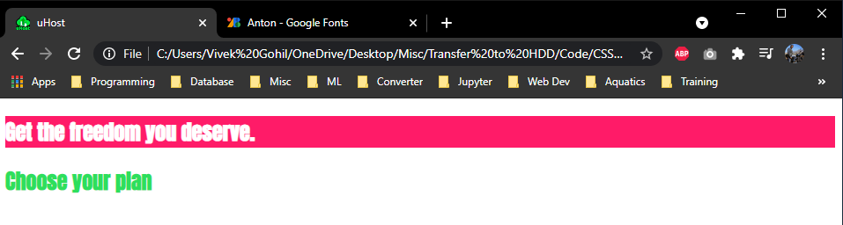
Apply the different style to both section

Slide 35
Why CSS is called as cascading style sheet ?
In our main.css file h1 tag selector and .section-title class selector both are pointing to same thing that is our h1 tag.
why it is not applying the style which we have defined in h1 tag ?
Class selector is overriding the tag selector as class selector have the higher specificity
You can check the same in chorme inspact

Slide 36
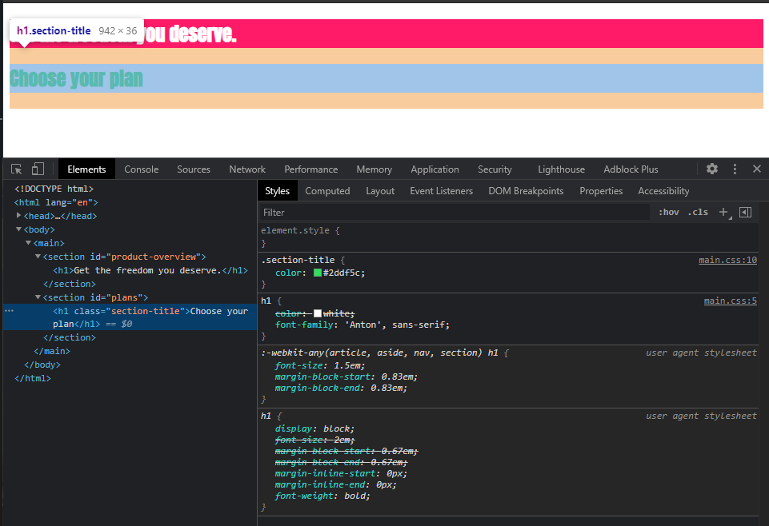
Why CSS is called as cascading style sheet ?

Slide 37
Cascading style sheets & specificity
Cascading
Specificity
Multiple Rules can apply to the same element
Resolve conflicts arising from multiple rules
Inline Styles
#ID selectors
.class, : pseudo-class and [attribute] selectors
<tag> and :: pseudo-element selectors

Slide 38
Understanding Inheritance
Child tag inherits the style(CSS) from the parent tag if no styles rules are defined for the current tag.
Lets implement the inheritance in our project by adding a global default font.
Which means if we don’t set the font still the html control will have the font set by us in CSS.
If we explicitly set the font in our CSS file then it will set the given font to the html control.

Slide 39
Understanding Inheritance
Add new paragraph text in plans section
As per current declaration of rules in our CSS file there is no default fonts for the paragraph tag.
Body is parent of all the child element in our page.
Add body tag selector in css file and set "Montserrat" font as default font.
Inheritance have very low specificity.

Slide 40
Understanding Inheritance
index.html
<head>
...
<link href="https://fonts.googleapis.com/css2?family=Anton&family=Montserrat:ital,wght@0,400;1,700&display=swap"
rel="stylesheet">
</head>
<main>
<section id="product-overview">
<h1>Get the freedom you deserve.</h1>
</section>
<section id="plans">
<h1 class="section-title">Choose your plan</h1>
<p>Make sure you get the most for your money</p>
</section>
</main>

Slide 41
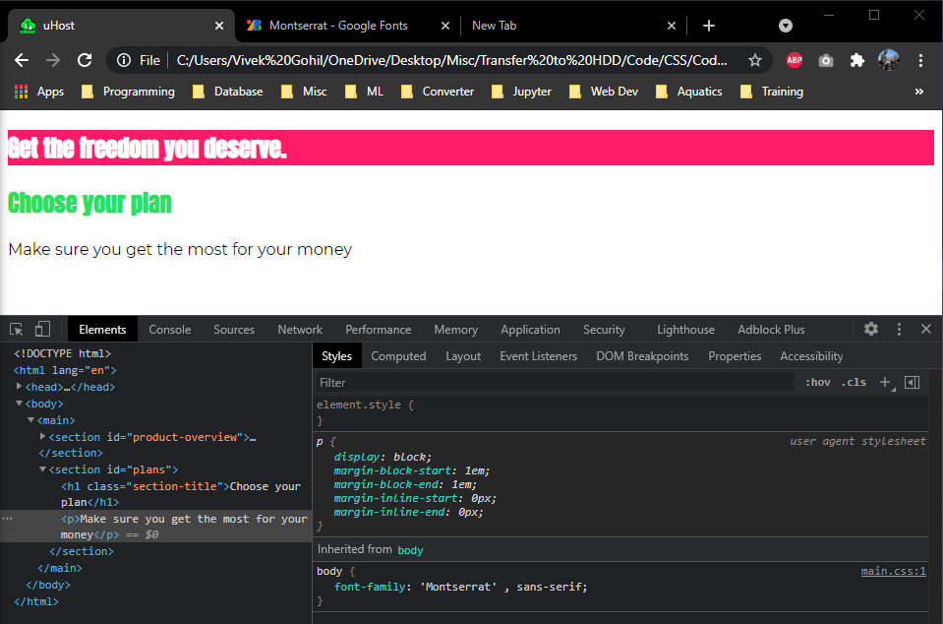
Understanding Inheritance
main.css
body{
font-family: 'Montserrat' , sans-serif;
}

Slide 42
Combinators in CSS
Descendant Combinators :- <space>
Adjacent Sibling Combinators :- +
General Sibling Combinators :- ~
Child Combinators :- >

Slide 43

Adjacent Sibling Combinators
h2 + p {
Color : red;
}
<div>
<h2>Not applied</h2>
<p>CSS applied</p>
<h2>Not applied</h2>
<h3>Not applied</h3>
<p>Not applied</p>
<h2>Not applied</h2>
<p>CSS applied</p>
</div>
Elements share the same parent
Second element comes
immediately after first element

Slide 44
General Sibling Combinators
h2 ~ p {
Color : red;
}
<div>
<h2>Not applied</h2>
<p>CSS applied</p>
<h2>Not applied</h2>
<h3>Not applied</h3>
<p>CSS applied</p>
</div>
Elements share the same parent
Second element comes after first element

Slide 45
Child Combinators
div > p {
Color : red;
}
<div>
<h2>Not applied</h2>
<p>CSS applied</p>
<div>Not applied</div>
<article>
<p>Not applied</p>
</article>
<p>CSS applied</p>
</div>
Second element is a direct
child of first element

Slide 46
Descendant Combinators
div p {
Color : red;
}
<div>
<h2>Not applied</h2>
<p>CSS applied</p>
<div>Not applied</div>
<article>
<p>CSS applied</p>
</article>
<p>CSS applied</p>
</div>
Second element is a descendant
of first element

Slide 47
Combinators in CSS
Currently the Choose your plan h1 tag is having the same font style as h1 of product-overview
Instead how to set the default font to Choose your plan h1 tag?

Slide 48
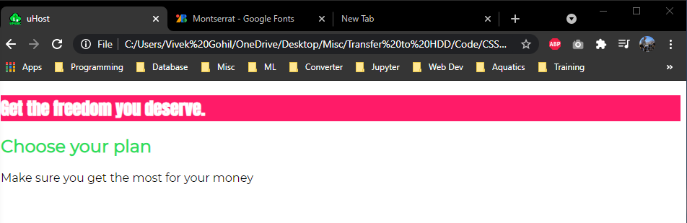
Combinators in CSS
Solution 1 using inheritance
Solution 2 using combinators
.section-title {
color: #2ddf5c;
font-family: inherit;
}
#product-overview h1 {
color: white;
font-family: 'Anton', sans-serif;
}

Slide 49
Quiz
What's a "Rule" in CSS?
The instruction HOW to style a given property.
A Combination of selector(WHAT to style) and declaration (HOW to style).
The import statement with points at an external CSS file.
Which selector would select this element?
#page-title{…}
page-title {…}
[page-title] {…}
.page-title {…}
<h1 class="page-title">Dive into the core features</h1>

Slide 50
Quiz
What is "Specificity" about?
Specificity is a CSS best practice which instructs you that you target an element with the most specific selector possible.
Specificity describes the fact that multiple CSS rules can target the same element.
Specificity is all about resolving conflicts that arise from multiple CSS rules which targes the same element.
What is a Combinator?
A CSS feature which allows you to combine two selectors in dependent way.
A CSS feature which allows you to combine two selectors in independent way.
A CSS feature which allows you to group a CSS rule by selectors.

Slide 51
Quiz
Why should you NOT use inline styles?
Because it has the lowest specifity.
Because the are only available on some HTML elements.
Because the code becomes harder to maintain and predict.

Slide 52
Assignment
Check the assignment-1 folder

Slide 53
Diving Deeper into CSS
Working with Boxes

Slide 54
Content
The Box Model
Height & Width
The display Property
Properties worth to remember
Pseudo classes and elements

Slide 55
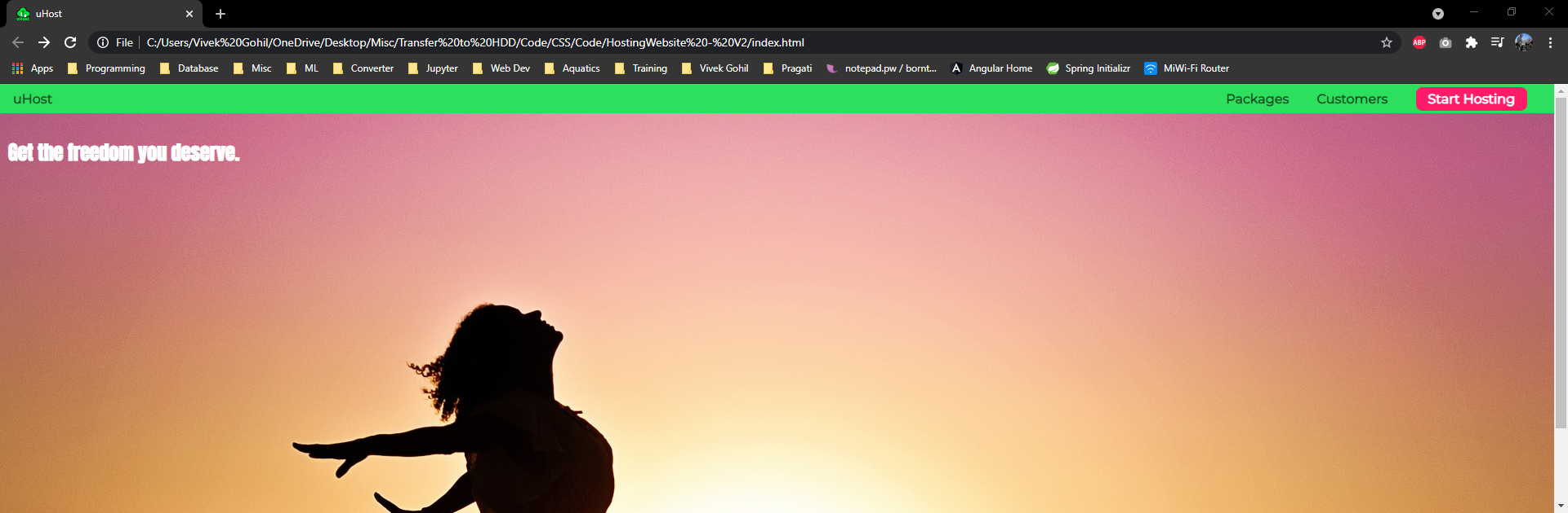
Project Goal Of This Module

Slide 56
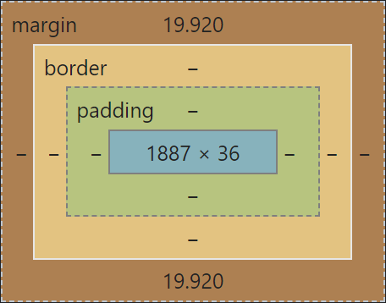
Understanding Box Model
Every element in HTML is interpreted as a box by CSS.
You can see that box in the Chrome developer tools if you inspect element.

Slide 57
Understanding Box Model
Lets change the red box i.e. product-overview section
Need little bit bigger
Apply border
Increase height and spacing from inside
Remove whitespace around the red box

Slide 58
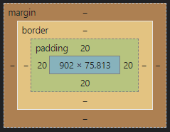
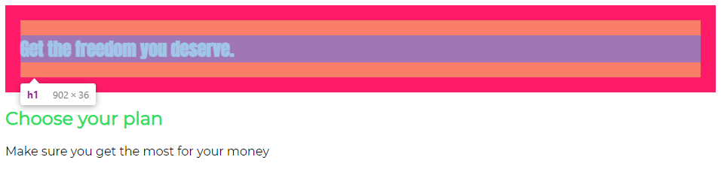
Understanding Box Model
Applying padding
#product-overview {
background: #ff1b68;
padding: 20px;
}

Slide 59
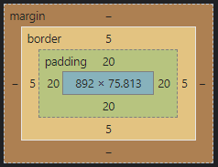
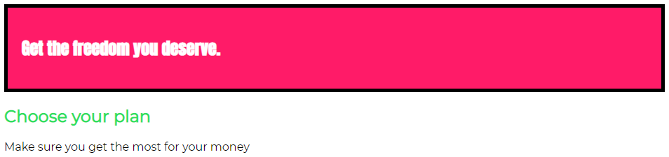
Understanding Box Model
Applying border
#product-overview {
background: #ff1b68;
padding: 20px;
border: 5px black solid;
}

Slide 60
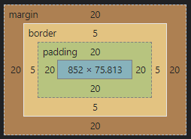
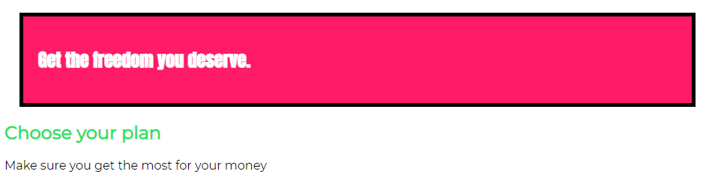
Understanding Box Model
Applying margin
#product-overview {
background: #ff1b68;
padding: 20px;
border: 5px black solid;
margin: 20px;
}

Slide 61
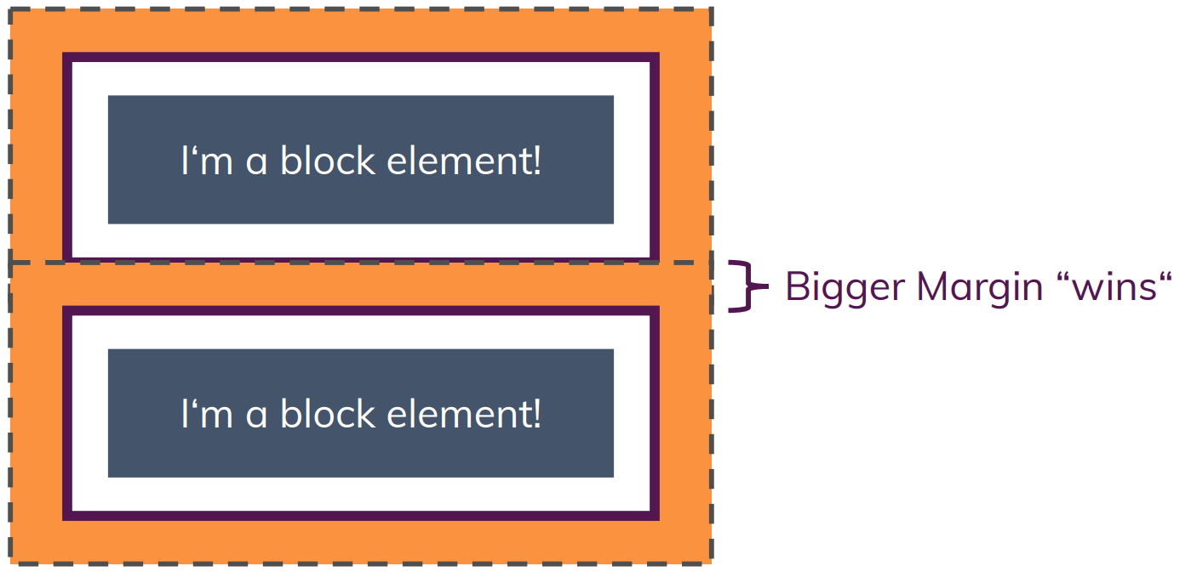
Margin Collapsing

Slide 62
Removing Default Margin
Observe the box model of product-overview.
There is an extra margin besides the margin set by us.
Default margin is set by the body. You can check this in chrome developer tools , inspect element.
Remove the default margin by adding the body tag declaration in main.css file
Now our product-overview is touching the edges of browser.

Slide 63
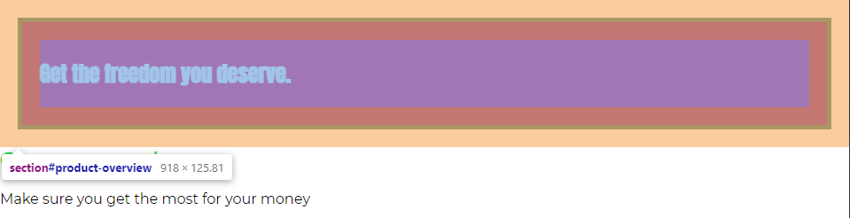
Removing Default Margin
body{
font-family: 'Montserrat' , sans-serif;
margin: 0;
}

Slide 64
Shorthand Properties
Combine values of multiple properties in a single property
Separate properties
Shorthand properties
border-width : 2px
border-style : dashed | solid
Border-color : orange
Border : 2px dashed orange
margin : 5px 10px 5px 10px
margin-top : 5px
margin-right : 10px
margin-bottom : 5px
margin-left : 10px
top & bottom
margin : 5px 10px
left & right
margin : 10px

Slide 65
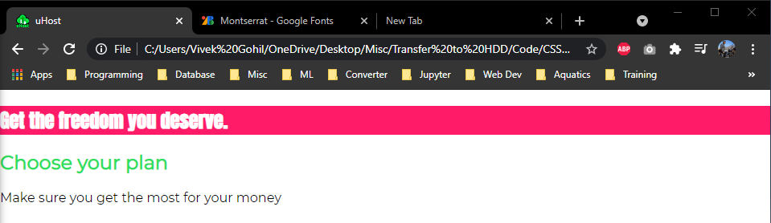
Setting Height & Width
Remove the padding , border , margin of product overview selection.
#product-overview {
background: #ff1b68;
}

Slide 66
Setting Height & Width
Set width to 100% - No difference in output.
Set the height to 100% - No difference in output.
Height and Width depends on its parent container.
Set the height of the product-overview as of browser window size.(try in chrome developer tools , inspect element)
Set the height of product-overview to 528px.

Slide 67
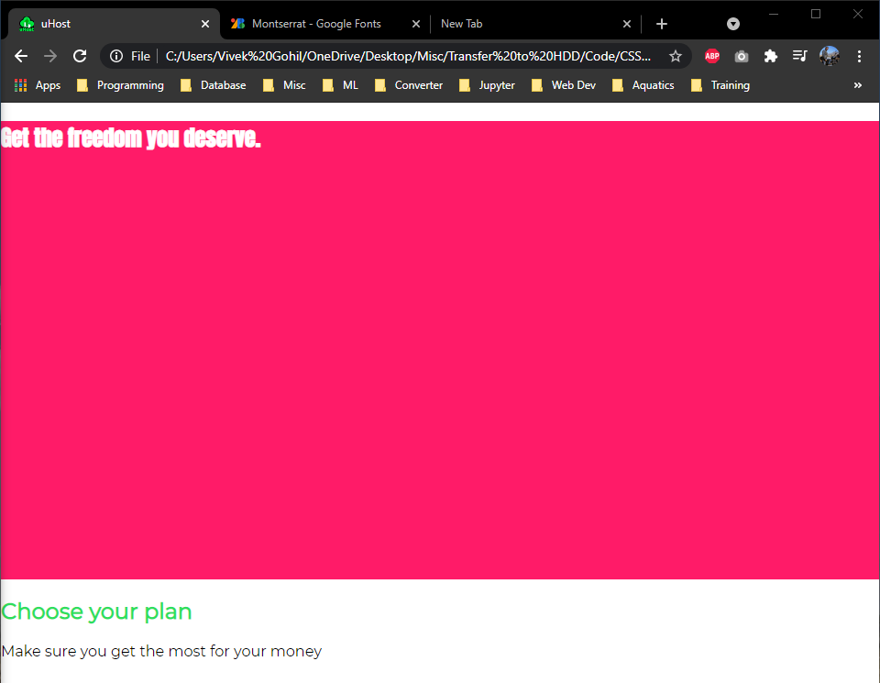
Setting Height & Width
#product-overview {
background: #ff1b68;
width: 100%;
height: 500px;
}

Slide 68
Setting Height & Width
margin
padding
content
height
width

Slide 69
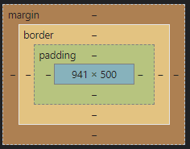
Setting Height & Width
What is included in our height and width from box-model.
Check in chrome development tools ,inspect element.
Margin , border , padding is not include when we set height and width.

Slide 70
Setting Height & Width
Add padding , border and margin to product-overview
After adding padding , border and margin page will get a horizontal scroll bar.
Page width is oversized , as padding ,border and margin is not included in our height and width settings.
To include padding and border (margin is not included) in our height and width size calculation set the box-sizing property to border-box (default :: content-box)
remove the margin set for the product-overview

Slide 71
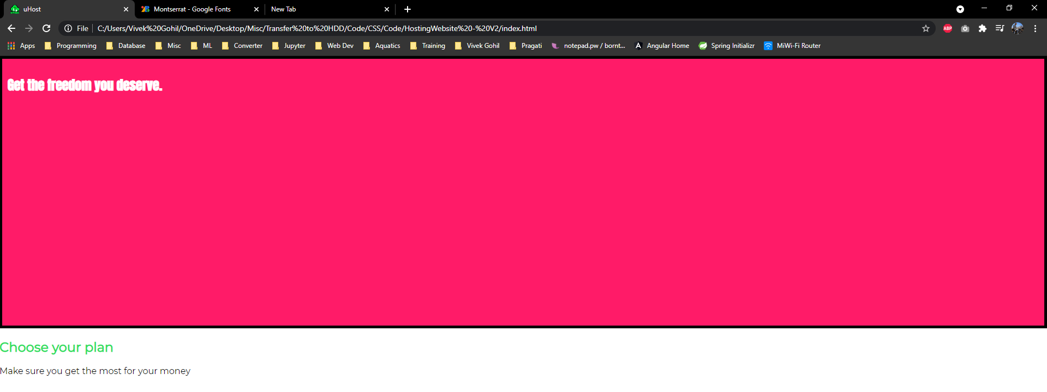
Setting Height & Width
#product-overview {
background: #ff1b68;
width: 100%;
height: 500px;
padding: 10px;
border: 5px solid black;
box-sizing: border-box;
}

Slide 72
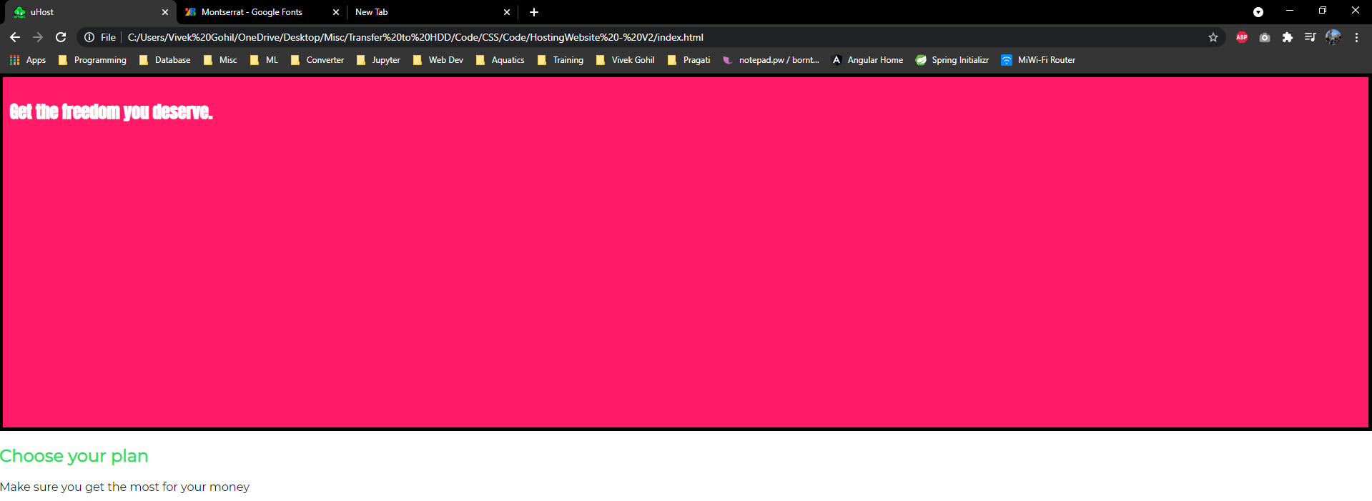
Setting Height & Width
Set the default style property to border-box for every element.
Remove border from product-overview
*{
box-sizing: border-box;
}
#product-overview {
background: #ff1b68;
width: 100%;
height: 500px;
padding: 10px;
}

Slide 73
Creating Header
Add title to the page.
Add list to with below list items
Packages
Customers
Start Hosting

Slide 74
Creating Header
<header>
<div>
<a href="index.html">
uHost
</a>
</div>
<nav>
<ul>
<li>
<a href="packages/index.html">Packages</a>
</li>
<li>
<a href="customers/index.html">Customers</a>
</li>
<li>
<a href="start-hosting/index.html">Start Hosting</a>
</li>
</ul>
</nav>
</header>

Slide 75
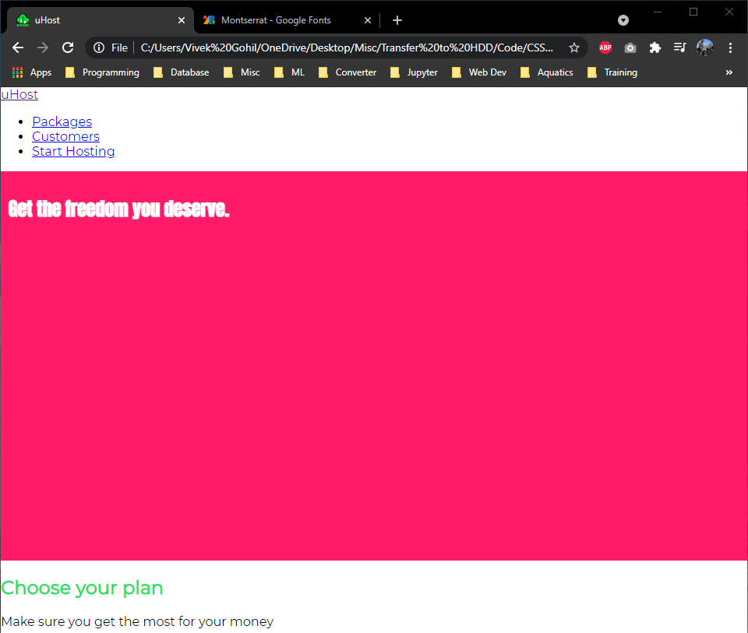
Creating Header

Slide 76
Decorate the Header
Do below listed thing on your own
Add a background colour
Add some padding
Set the width to the full page width

Slide 77
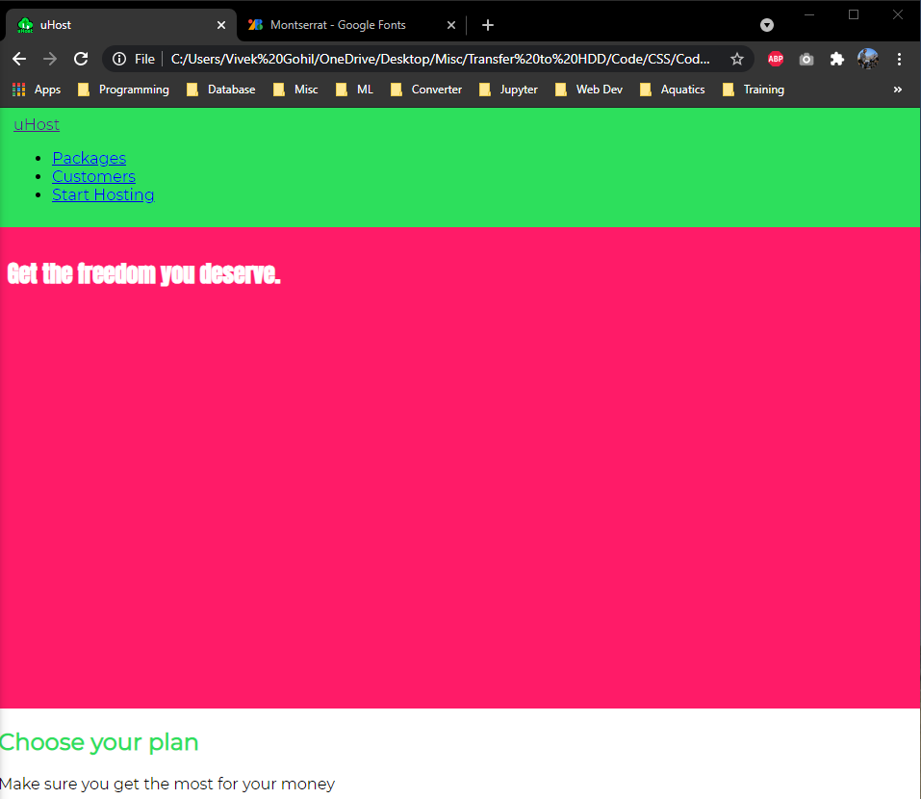
Decorate the Header
Define a class as main-header to the header tag
.main-header{
width: 100%;
background: #2ddf5c;
padding: 8px 16px;
}

Slide 78
Display property
Change the display property of list from inline-block to inline. To make it appear like menu.

Slide 79
Display property
index.html
<nav class="main-nav">
<ul class="main-nav__items">
<li class="main-nav__item">
<a href="packages/index.html">Packages</a>
</li>
<li class="main-nav__item">
<a href="customers/index.html">Customers</a>
</li>
<li class="main-nav__item">
<a href="start-hosting/index.html">Start Hosting</a>
</li>
</ul>
</nav>
main.css
.main-nav__item {
display: inline-block;
}

Slide 80
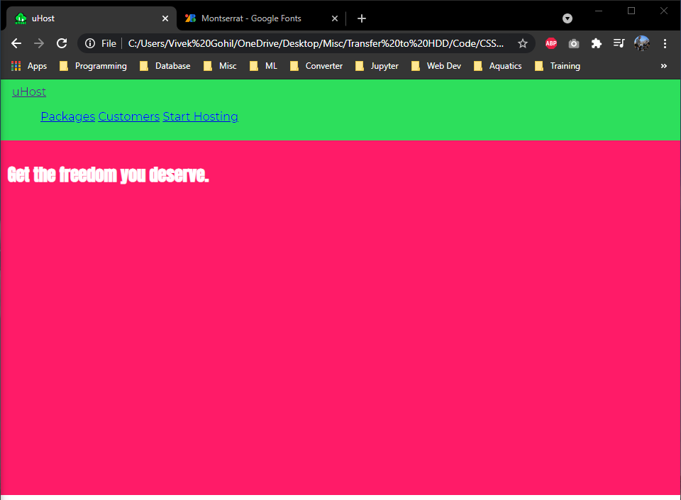
Display property

Slide 81
Display Property And Navigation Bar
Display the title div and nav inline to make it look better.
Achieve this using combinators
.main-header > div {
display: inline-block;
}
.main-nav{
display: inline-block;
}

Slide 82
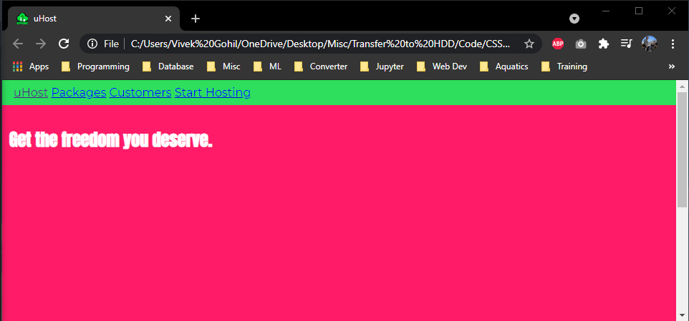
Display Property And Navigation Bar
Remove the default margin and padding of the main-nave__items and set 0
Remove the bullet points from list items
.main-nav__items{
margin: 0;
padding: 0;
list-style:none;
}

Slide 83
Display Property And Navigation Bar
Move elements in nav elements to the right.
Set width = main-nav – title div
Remove the white space / new line between the div and main-nav if you are getting element on new line
.main-nav{
display: inline-block;
text-align: right;
width: 90%;
}
.main-nav{
display: inline-block;
text-align: right;
/* width: 90%; */
width: calc(100% - 50px);
}

Slide 84
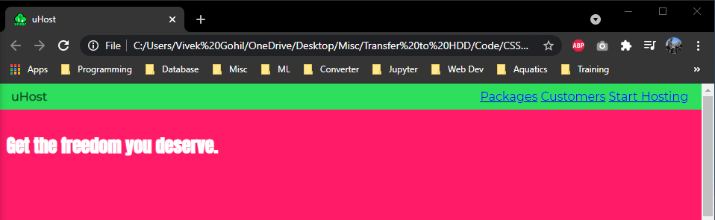
Decorate Title
Add class to the title link
Remove the hyperlink underline
Change the color
Make it bold
.main-header {
width: 100%;
background: #2ddf5c;
padding: 8px 16px;
}

Slide 85
Decorate Title
Set the center align the title and menu in the header.
.main-header > div {
display: inline-block;
vertical-align: middle;
}
.main-nav{
display: inline-block;
text-align: right;
/* width: 90%; */
width: calc(100% - 50px);
vertical-align: middle;
}

Slide 86
Decorate Menu : Task
Style the menu links
Add distance between the menu items
Remove the link underline
Change font color

Slide 87
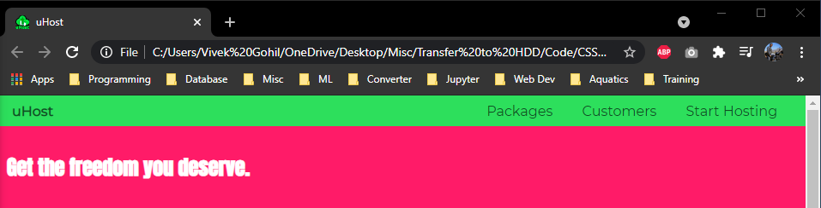
Decorate Menu : Solution
.main-nav__item {
display: inline-block;
margin: 0 15px;
}
.main-nav__item a {
text-decoration: none;
color: #0e4f1f;
}

Slide 88
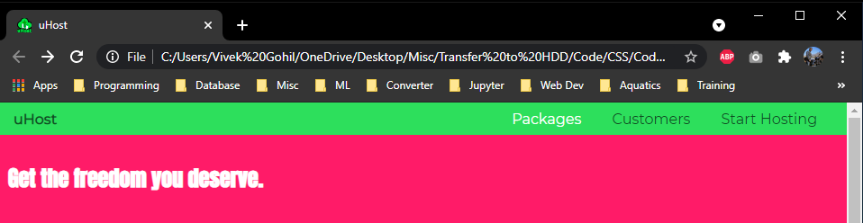
Decorate Menu : Adding Pseudo Class
Add hover over effect to the menu items
.main-nav__item a:hover {
color: white;
}
.main-nav__item a:active {
color: white;
}

Slide 89
Decorate Menu : Grouping Rules
We can group the hover and active rule as they have the same declaration.
.main-nav__item a:hover,
.main-nav__item a:active {
color: white;
}

Slide 90
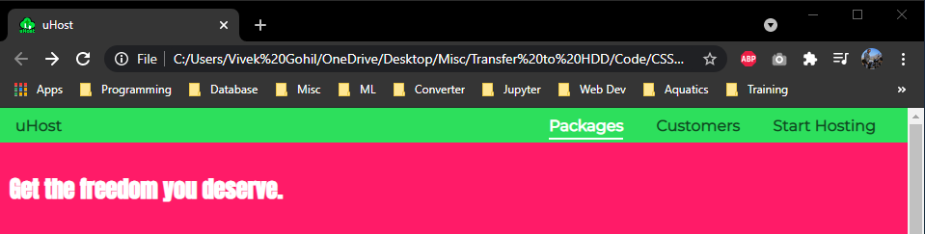
Decorate Menu
Menu items to be bold by default
Add bottom border with padding when we hover over on menu item
.main-nav__item a {
text-decoration: none;
color: #0e4f1f;
font-weight: bold;
padding: 3px 0px ;
}
.main-nav__item a:hover,
.main-nav__item a:active {
color: white;
border-bottom: 2px solid white;
}

Slide 91
Decorate Menu : Make CTA (Call to action)
Make a start hosting list item as a CTA button.
Add extra class to start hosting list item (not to a hyperlink tag)
Consider the main-nav__item specificity and declare the style in CSS file.

Slide 92
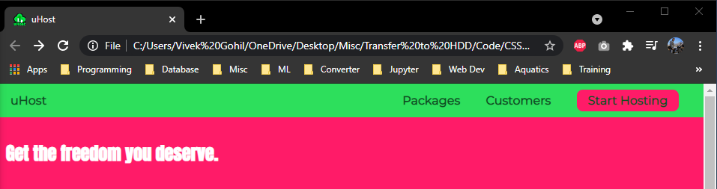
Decorate Menu : Make CTA (Call to action)
<ul class="main-nav__items">
<li class="main-nav__item">
<a href="packages/index.html">Packages</a>
</li>
<li class="main-nav__item">
<a href="customers/index.html">Customers</a>
</li>
<li class="main-nav__item main-nav__item__cta">
<a href="start-hosting/index.html">Start Hosting</a>
</li>
</ul>
.main-nav__item__cta a{
color: white;
background: #ff1b68;
padding: 5px 15px;
border-radius: 8px;
}

Slide 93
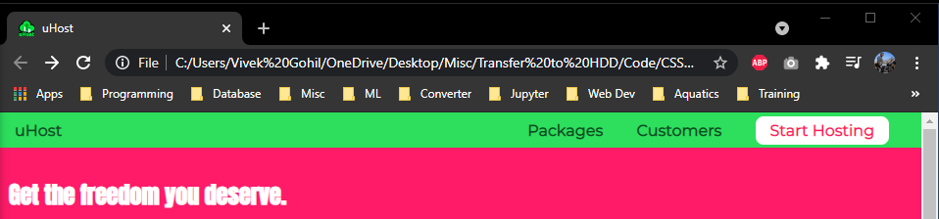
Decorate Menu : Make CTA (Call to action)
Change the hover over effect for the CTA button and remove the border.
.main-nav__item__cta a:hover,
.main-nav__item__cta a:active{
color: #ff1b68;
background: white;
border: none;
}

Slide 94
Adding Image
Add background image for the product-overview section
#product-overview {
/* background: #ff1b68; */
background: url("freedom.jpg");
width: 100%;
height: 500px;
padding: 10px;
}

Slide 95
Code
Backup your code

Slide 96
Practicing the Basics
Can’t do that enough!

Slide 97
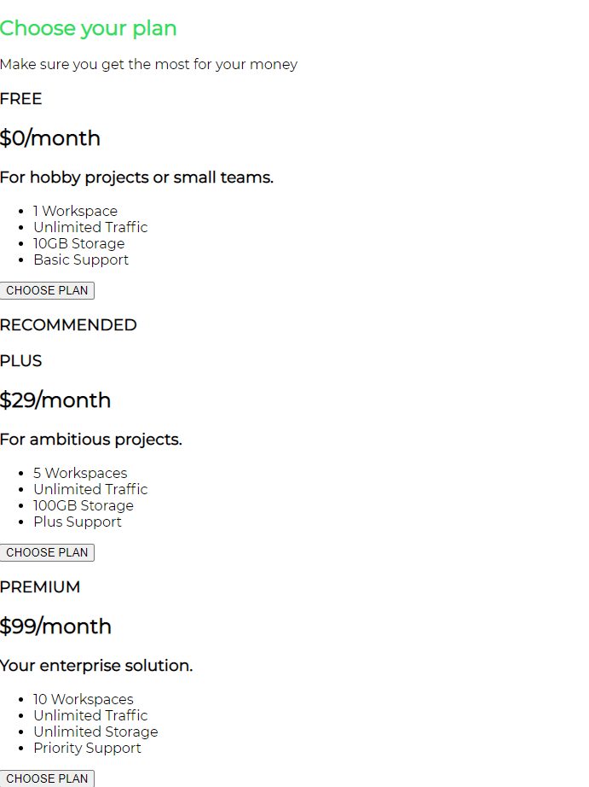
Decorate Plans Section
Add more content to the plans section
Create new div and add below code
<article class="plan">
<h1 class="plan__title">FREE</h1>
<h2 class="plan__price">$0/month</h2>
<h3>For hobby projects or small teams.</h3>
<ul class="plan__features">
<li>1 Workspace</li>
<li>Unlimited Traffic</li>
<li>10GB Storage</li>
<li>Basic Support</li>
</ul>
<div>
<button>CHOOSE PLAN</button>
</div>
</article>

Slide 98
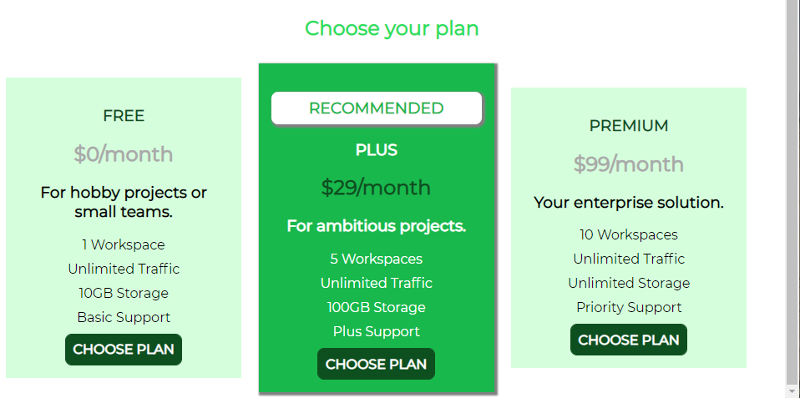
Decorate Plans Section : Goal

Slide 99
Decorate Plans Section
Add class as plan to article tag.
Change background color.
Center align the text.
Add spacing around text.
Add spacing between plans.

Slide 100
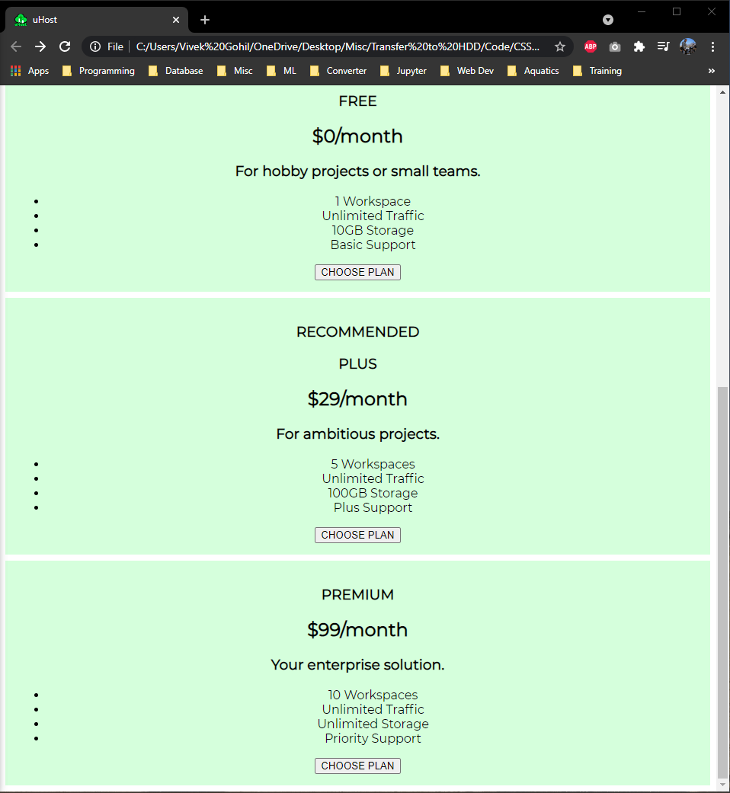
Decorate Plans Section
Add more content to the plans section
Create new div and add below code
<article class="plan">
//unchanged code
</article>
.plan {
background: #d5ffdc;
text-align: center;
padding: 15px;
margin: 8px;
}

Slide 101
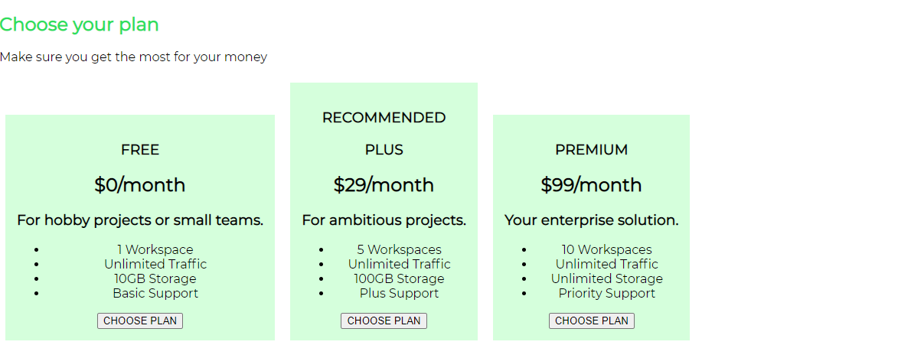
Decorate Plans Section
Display all three plans sit in the same row.
.plan {
background: #d5ffdc;
text-align: center;
padding: 15px;
margin: 8px;
display: inline-block;
}

Slide 102
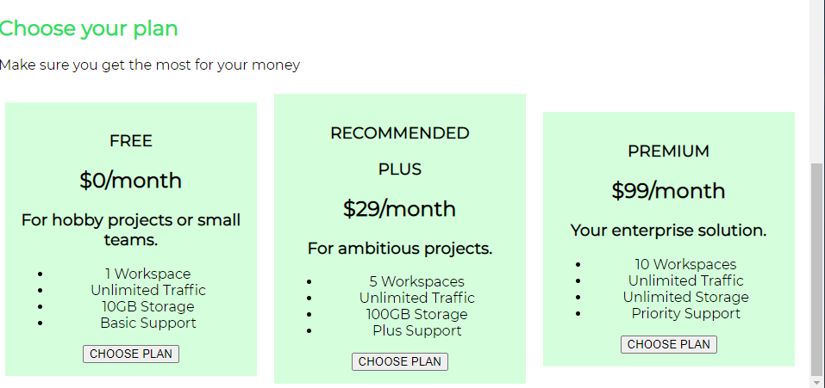
Decorate Plans Section
Set the plan width as the page width for plans to occupy the full page.
.plan {
background: #d5ffdc;
text-align: center;
padding: 15px;
margin: 8px;
display: inline-block;
width: 30%;
vertical-align: middle;
}

Slide 103
Decorate Plans Section : Task
Set center align to the text “Choose your plan”

Slide 104
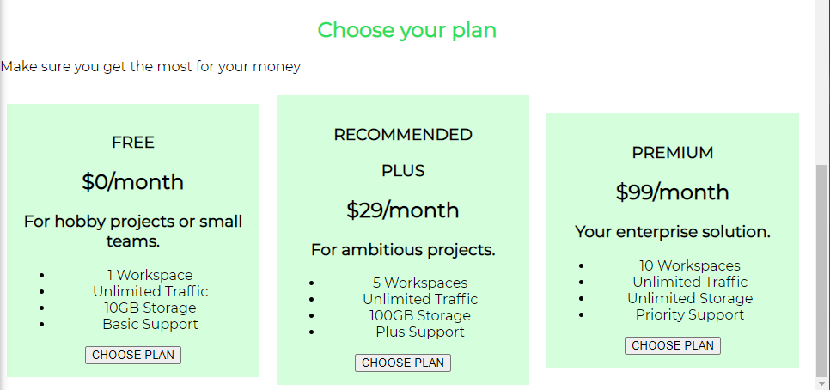
Decorate Plans Section : Solution
.section-title {
color: #2ddf5c;
text-align: center;
}

Slide 105
Decorate Plans Section : Task
Decorate the middle(Recommended) plan
Change background color and text color

Slide 106
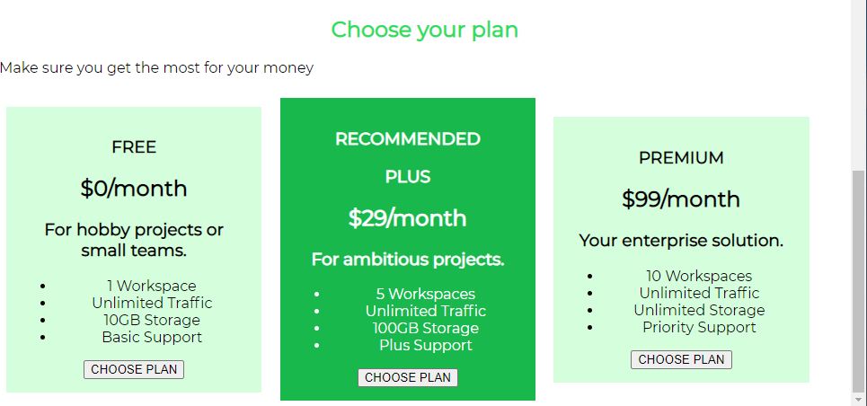
Decorate Plans Section : Solution
Add second class to highlight the middle plan
Add class to h1 tag
<article class="plan plan--highlighted">
<h1 class="plan__annotation">RECOMMENDED</h1>
//unchanged code
</article>
.plan--highlighted{
background: #19b84c;
color:white;
}

Slide 107
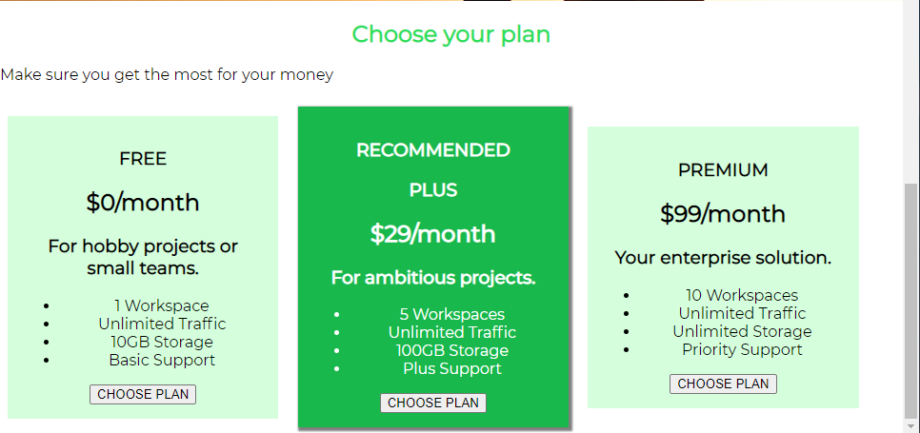
Decorate Plans Section
Add shadow effect to the recommended plan
.plan--highlighted{
background: #19b84c;
color: white;
box-shadow: 2px 2px 2px 2px rgba(0,0,0,0.5)
}

Slide 108
Decorate Plans Section : Task
Design the recommended plan as badge.
Change the background to white
Change the text to green
Add some padding
Add shadow effect

Slide 109
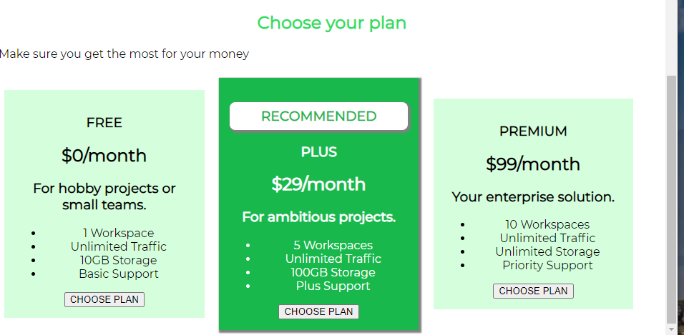
Decorate Plans Section : Solution
.plan__annotation{
background: white;
color: #19b84c;
padding: 8px;
box-shadow: 2px 2px 2px 2px gray;
border-radius: 8px;
}

Slide 110
Decorate Plans Section : Task
Style the list – bullet points
Remove the bullet points
Arrange the padding and margin

Slide 111
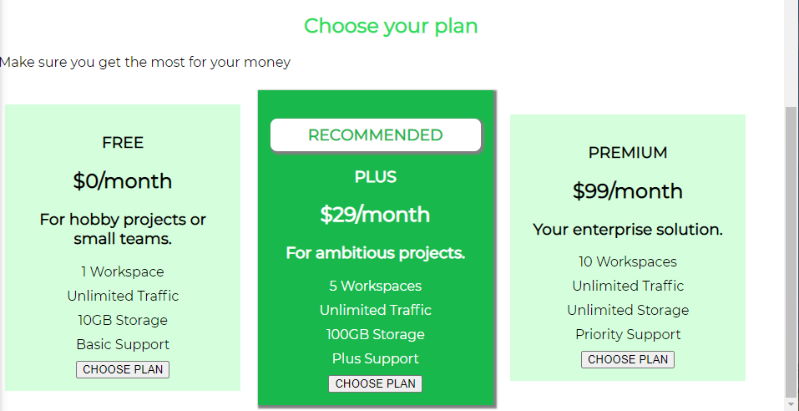
Decorate Plans Section : Solution
<ul class="plan__features">
<li>1 Workspace</li>
<li>Unlimited Traffic</li>
<li>10GB Storage</li>
<li>Basic Support</li>
</ul>
.plan__features {
list-style: none;
margin: 0;
padding: 0;
}
.plan__features li{
margin: 10px 0px;
}

Slide 112
Decorate Plans Section : Task
Decorate plan title
Add plan__title class to the title
Change the font color
Decorate plan price
Add plan__price class to the price
Change the font color

Slide 113
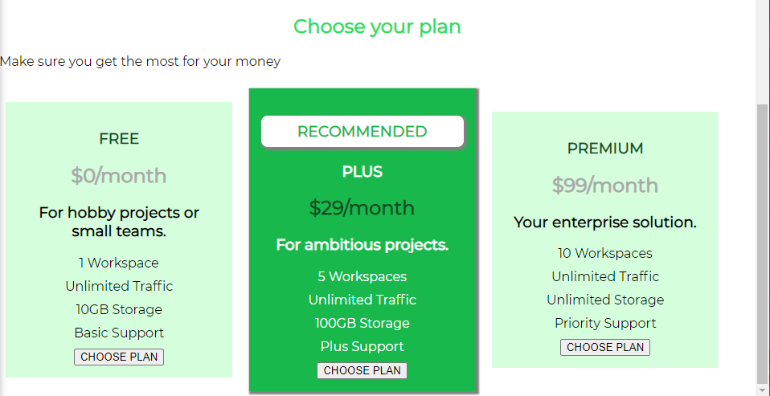
Decorate Plans Section : Solution
.plan__title{
color: #0e4f1f;
}
.plan__price{
color: darkgray
}
.plan--highlighted .plan__price
{
color: #0e4f1f;
}
.plan--highlighted .plan__title
{
color: white;
}

Slide 114
Decorate Plans Section : Task
Decorate choose plan buttons
Add button class to button
Change background color
Change font color
Remove all default styles applied by browser
Set default font
Set padding and order
Rounded the corners of buttons
Set bold font
Add hover over effect
Change the cursor from default to pointer

Slide 115
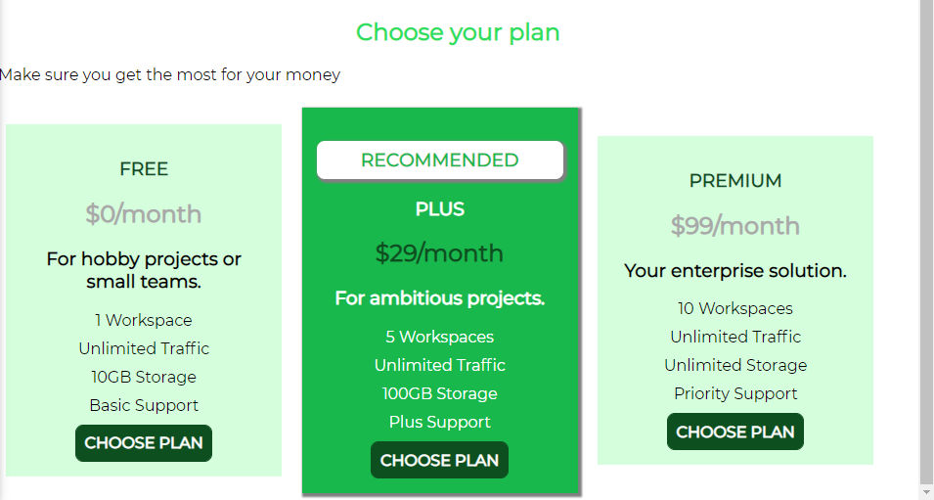
Decorate Plans Section : Solution
.button{
background: #0e4f1f;
color: white;
font: inherit;
border: 1.5px solid #0e4f1f;
padding: 8px;
border-radius: 8px;
font-weight: bold;
cursor: pointer;
}
.button:hover ,
.button:active
{
background: white;
color: #0e4f1f;
}

Slide 116
Decorate Plans Section
Remove the Make sure you get the most for your money paragraph.

Slide 117
Adding Decorate Many Good Reasons section in page
<section id="key-features">
<h1 class="section-title">Many Good Reasons to Stick Around</h1>
<ul class="key-features__list">
<li class="key-feature">
<div class="key-feature__image"> </div>
<p class="key-feature__description">3,857,000 Trusting Customers</p>
</li>
<li class="key-feature">
<div class="key-feature__image">
</div>
<p class="key-feature__description">99.999% Uptime Guarantee</p>
</li>
<li class="key-feature">
<div class="key-feature__image">
</div>
<p class="key-feature__description">Lightning Fast CDN</p>
</li>
</ul>
</section>

Slide 118
Decorate Many Good Reasons section
Change font color of title
Change background color of section
Give some spacing around and top
Convert the list item from inline to block
Give spacing around and between the list items.
Change the font color of list items

Slide 119
Decorate Many Good Reasons section : Task
Set color to title
Change background color of section
Give some spacing around and top

Slide 120
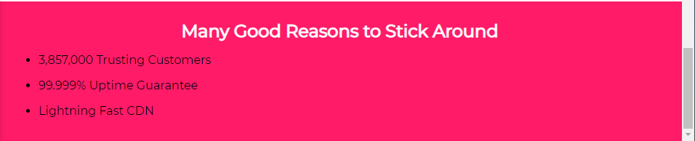
Decorate Many Good Reasons section : Solution
#key-features {
background: #ff1b68;
padding: 16px;
margin-top: 30px;
}
#key-features .section-title{
color: white;
margin: 10px ;
}

Slide 121
Decorate Many Good Reasons section : Task
Convert the list item from inline to block
Give spacing around and between the list items.
Change the font color of list items

Slide 122

Decorate Many Good Reasons section : Solution
.key-features__list {
list-style: none;
margin: 0;
padding: 0;
}
.key-feature {
display: inline-block;
width: 33%;
text-align: center;
}
.key-feature__description{
text-align: center;
font-weight: bold;
color: white;
font-size: 20px;
}

Slide 123

Decorate Many Good Reasons section
Add a circle above each text with background color.
.key-feature__image{
border: 2px solid #424242;
background: #ffcede;
width: 120px;
height: 120px;
border-radius: 50%;
}
.key-feature__description{
text-align: center;
font-weight: bold;
color: white;
font-size: 20px;
}

Slide 124

Decorate Many Good Reasons section
Canter align the circles
.key-feature__image{
border: 2px solid #424242;
background: #ffcede;
width: 120px;
height: 120px;
border-radius: 50%;
margin: auto;
}
.key-feature__description{
text-align: center;
font-weight: bold;
color: white;
font-size: 20px;
}

Slide 125
Footer
Create footer below the main section.
Set main-footer class to footer
<footer>
<nav>
<ul>
<li>
<a href="#">Support</a>
</li>
<li>
<a href="#">Terms of Use</a>
</li>
</ul>
</nav>
</footer>

Slide 126
Footer : Task
Style the footer
Change background color
Change text color
Remove the space between footer and Many Good Reasons section
Add some space around the text
Remove the hyperlink text decoration
Display both links in same line (inline)
Display the text in the center of the footer
Add hover over effect.

Slide 127
Footer : Solution
<footer class="main-footer">
<nav>
<ul class="main-footer_links">
<li class="main-footer__link">
<a href="#">Support</a>
</li>
<li class="main-footer__link">
<a href="#">Terms of Use</a>
</li>
</ul>
</nav>
</footer>

Slide 128

Footer : Solution
.main-footer{
background: black;
padding: 10px;
}
.main-footer_links{
list-style: none;
margin: 0;
padding: 0;
text-align: center;
}
.main-footer__link
{
display: inline-block;
margin: 0 16px;
}
.main-footer__link a
{
text-decoration: none;
color: white;
}
.main-footer__link a:hover,
.main-footer__link a:active
{
color: #ccc;
}

